Slide 1

Project 3 – Is It Real or Fake News
Matthew Belevski
Christy Wang
Sherry Javed

Slide 2

Proposal of our Project
To find out if the News published on the website are “Real” or “Fake”

Slide 3
Final Project Requirements:
Technologies learned and used in our project:
Logistic Regression
Python Pandas
HTML/CSS
Tableau
Hosting application using Heroku tool.

Slide 4
Datasets
Fake and real news dataset – Kaggle.com
https://www.kaggle.com/clmentbisaillon/fake-and-real-news-dataset?select=Fake.csv
Github repo with headlines from r/nottheonion and theonion.com
https://github.com/lukefeilberg/onion/blob/master/OnionOrNot

Slide 5
Cleaning the data
Use of pandas to:
Import the Real and Fake news csv files from Kaggle into dataframe
Real News = 1
Fake News = 0
Import OnionOrNot csv into dataframe and swap the 0 and 1 values to match our system
Combine both dataframes into one dataframe

Slide 6
Machine Learning
Removal of stop words
Train Test Split – 75-25 split
Count vectorizer to create matrix of counts for each word in headline
Use of Logistic Regression
Tested our model using Area Under Curve (ROC_AUC) which gave us 94% accuracy
Save model and count vectorizer for use on the website

Slide 7
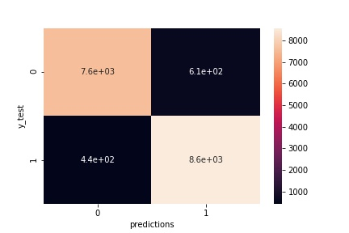
Machine Learning – Confusion Matrix
Actual
(7600)
(610)
Actual
(440)
(8600)

Slide 8
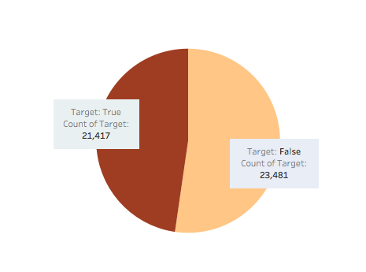
Data Exploratory ﻿Number of Fake news vs. True news (Output from Tableau)
Nearly balanced dataset

Slide 9
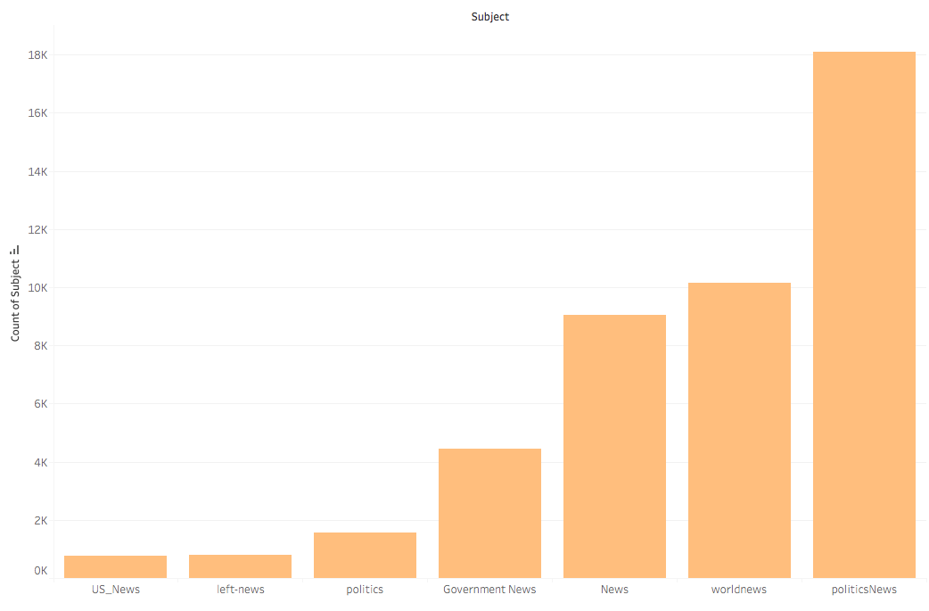
Data Exploratory ﻿ ﻿News Categories Counts (Output from Tableau)
Politics news dominates one third of the datasets

Slide 10
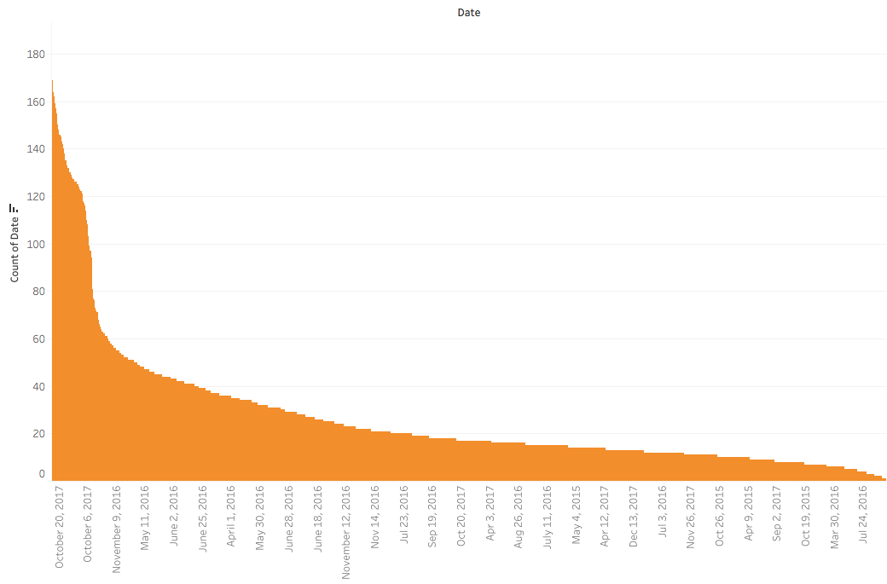
Data Exploratory ﻿ ﻿﻿Count of Dates (Output from Tableau)
News are mainly between 2016-2017

Slide 11
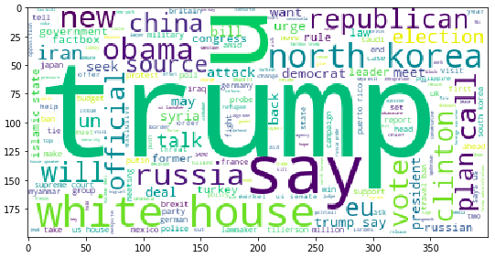
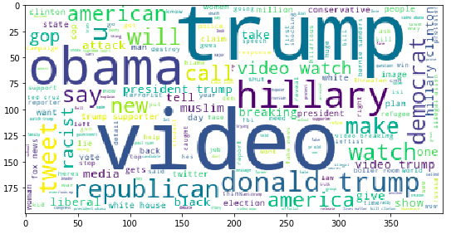
Data Exploratory ﻿ ﻿﻿Word Clouds (Output from Python)
Frequently used words in title for True News
Frequently used words in title for Fake News

Slide 12
Let's head towards our Practical demonstration
IS IT REAL OR FAKE NEWS?

